Slide 1

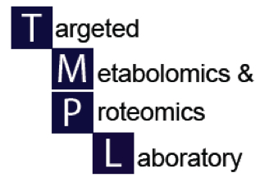

Pathway analysis in metabolomics
UAB Metabolomics Workshop
December 2, 2015
Steve Barnes, PhD

Slide 2
Overview
In the previous steps, we have used MetaboAnalyst to carry out statistical analyses of the metabolomics data
For LC-MS data we have not yet determined what each metabolite ion is (see next talk from Jeevan Prasain how we proceed to do that)
Nonetheless, we want to map these data to understand how they connected
There are two options
  To take the NMR assignments or identify each metabolite ion and map these to known pathways
  Identify ions that are chemically connected based on mass differences (Mummichog – Li et al., 2013)

Slide 3
Academic pathway analysis tools
For a resource for all available pathway softwares, go to:
  http://omictools.com/metabolic-pathways-c170-p1.html
BioCyc (Peter Karp, SRI Intl) – incorporates MetaCyc
  http://biocyc.org/
  http://www.ncbi.nlm.nih.gov/pubmed/24225315
HumanCyc
  http://humancyc.org
  http://www.ncbi.nlm.nih.gov/pubmed/15642094
KEGG pathway mapping
  http://www.genome.jp/kegg/tool/map_pathway1.html

Slide 4
KEGG pathway tool
As for the other pathway tools, KEGG requires that the metabolite has been identified
This could be putative identification (from METLIN – see next talk by Dr. Prasain) and confirmed identification based on MSMS analysis and interpretation (again, see Dr. Prasain’s talk)
  Go to http://www.genome.jp/kegg/tool/map_pathway1.html
  Enter the KEGG ID numbers for the identified metabolites
  E.g., C00022 for pyruvate

Slide 5
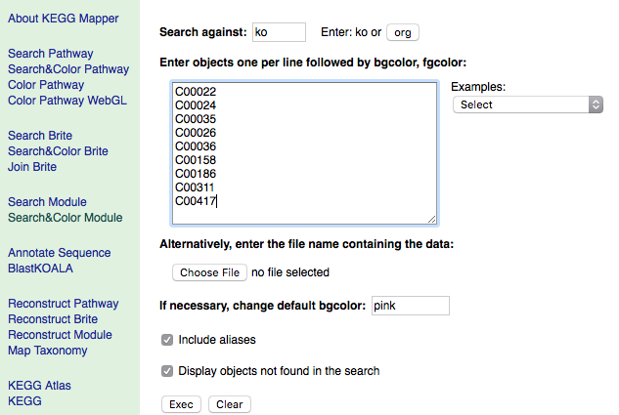

Slide 6
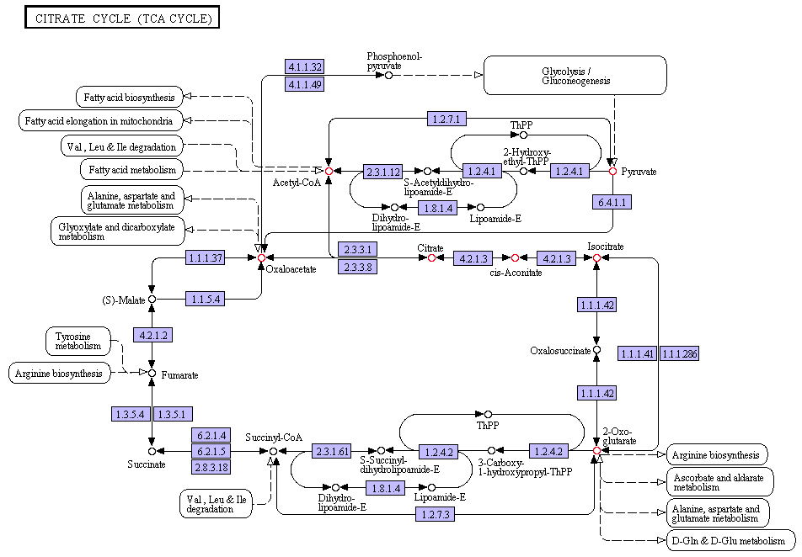
Ions in this pathway

Slide 7

What to do when you don’t know what the metabolites ions are?
Mummichog (Li et al., 2013)
  This software looks for ions that are associated with one another (non-pathway mapping)
  And maps all possible metabolite identities (based on accurate MS1 data) on to known pathways

Slide 8
Mummichog pathway mapping
  Divides the ions into significant and non-significant groups
  Let’s say there are 1000 ions of which there are 150 ions with p-values <0.05.
    These are separated from the non-significant ions (850)
  150 of the remaining non-significant ions are taken at random and mapped onto known pathways
    This is repeated 100 or more times
    This provides the likelihood of random association of non-significant ions with pathways
  The significant ions are now mapped to the pathways and evidence is sought for enhanced associations (Fisher exact test)

Slide 9
Why non-pathway mapping?
Many of the pathways were established by experiments conducted >50 years ago
More recent appreciation of the importance of the gut microbiome
And there are other “genomes” to consider
  The food we eat/drink
  The effects of food processing
  The “therapeutics-ome”
  The environment-ome
The existing pathways in pathway search tools do not take this into account

Slide 10
How to run mummicog
It runs in the terminal command line mode
Mummichog software (currently version 1.0.5) is downloadable
  https://code.google.com/p/atcg/wiki/mummichog_for_metabolomics
  Load it into the Applications folder
It’s also necessary to have downloaded Anaconda python 2.7 (do not use 3.0)
  http://docs.continuum.io/anaconda/install
  My version is saved in Macintosh HD/anaconda/bin folder

Slide 11
Need to prepare a .txt file of all the metabolite ions (significant and non-significant)
In Excel, create the following columns of data (transfer from MetaboAnalyst output file - peak_normalized_rt_mz.csv):
  The m/z value of each metabolite
  The retention time of each metabolite
  The p-value for the difference in groups for each metabolite (TTEST function in Excel)
  The t-score for the difference in groups for each metabolite (need to add a formula – see next slide)
  (optional) a tracking ID number

Slide 12
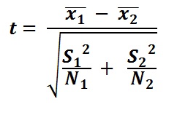
The t-score
Difference in the means
Pooled variance
If the sample data for group 1 are in columns H-N and for group 2 in columns O-U, the the t-score for the metabolite in row 2 is
ABS(average(H2:N2)-average(O2:U2)/SQRT((STDEV(H2:N2)^2)/7+(STDEV(O2:U2)^2)/7)
This formula can be copied to all the other rows
Save the file in .txt format into the test folder inside the Mummichog folder in Applications

Slide 13
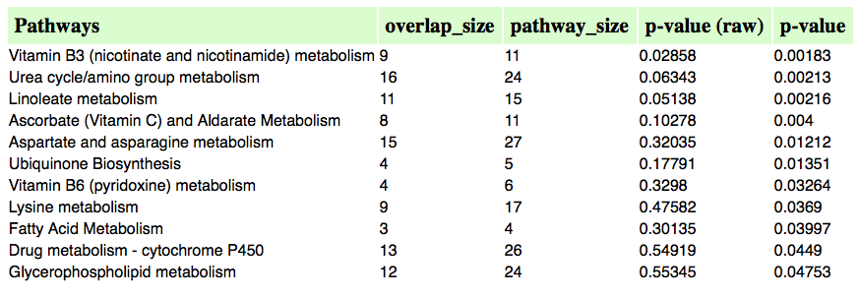
Output of Mummichog
Pathway enhancement

Slide 14
Go to URL in Mummichog output

Slide 15
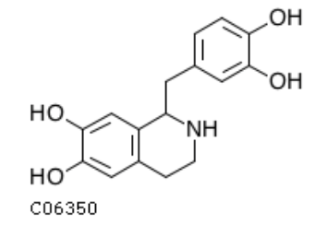
KEGG C06350 metabolite
Tetrahydropapaveroline
An endogenous opiate

